Slide 1
Xamarin Workbooks
Oleksandr Krakovetskyi
CEO DevRain Solutions, devrain.com
Microsoft Regional Director (Ukraine)
Microsoft Most Valuable Professional
@msugvnua
https://www.facebook.com/alex.krakovetskiy

Slide 2
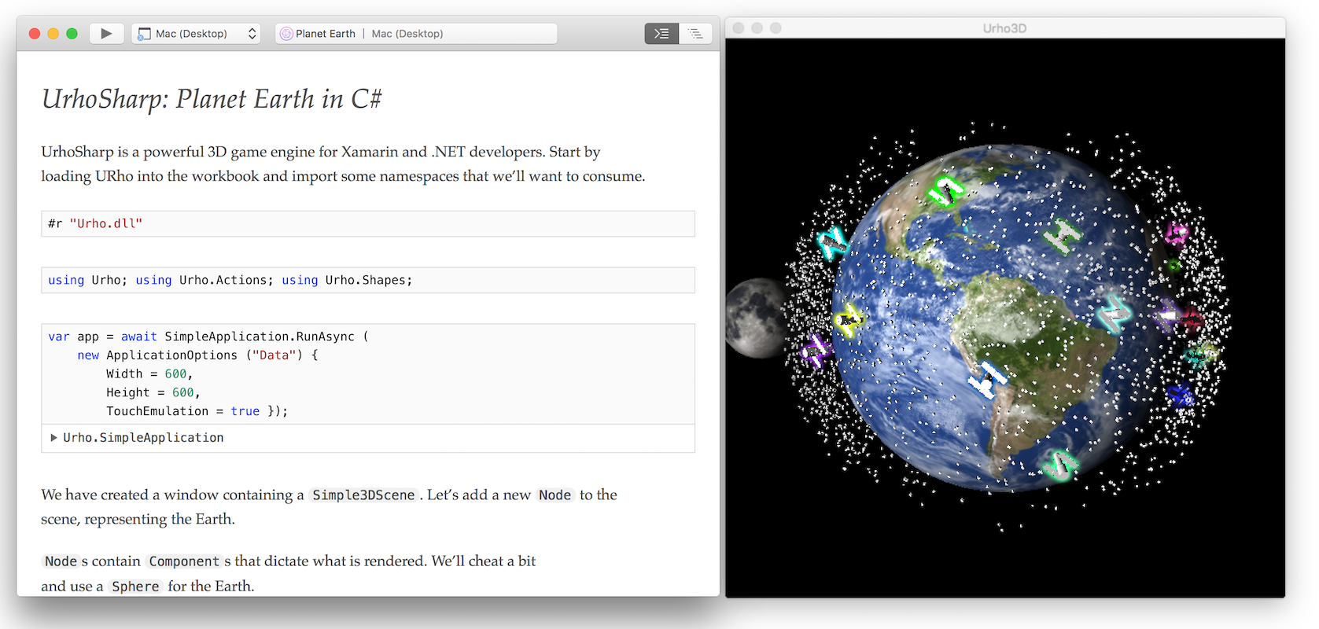
Xamarin Workbooks
Workbooks are live documents
They contain Markdown text
With embedded C# code
The code executes on demand
And re-executes any code after you make changes

Slide 3
Supported Operating Systems
Mac - OS X 10.11 or greater
Windows - Windows 7 or greater (with Internet Explorer 11 or greater and .NET 4.6 or greater)

Slide 4
Supported App Platforms
APP PLATFORM | OS SUPPORT | NOTES
Mac (Unified) | Only supported on Mac
iOS (Unified) | Supported on Mac and Windows | Xamarin Studio 6.1, Xamarin.iOS, and Xcode 8.1 must be installed on Mac. Running iOS workbooks on Windows requires a Mac build host running all of the above, and Xamarin Workbooks installed there as well.
Android | Supported on Mac and Windows | Must use Google, Visual Studio or Xamarin Android emulator, with a virtual device >= 4.4
WPF | Only supported on Windows
Console | Supported on Mac and Windows

Slide 5
References
Xamarin Workbooks https://developer.xamarin.com/guides/cross-platform/workbooks/
Samples: https://github.com/xamarin/Workbooks
https://developer.xamarin.com/workbooks/
Telegram group: https://t.me/xamarin_ukraine

Slide 6

Questions?
Oleksandr Krakovetskyi
CEO, DevRain Solutions
Microsoft MVP, Microsoft RD
alex.krakovetskiy@devrain.com
https://www.facebook.com/alex.krakovetskiy
@msugvnua

